Slide 1
I-85 Widening Project MM 98-106
Cherokee County
Public Hearing
March 14, 2017

Slide 2
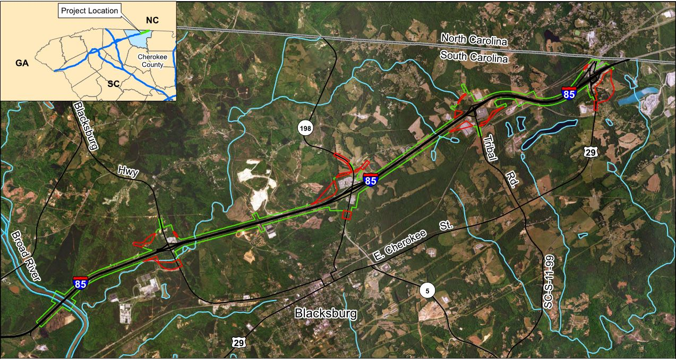
PROJECT LIMITS
Project Location Map

Slide 3
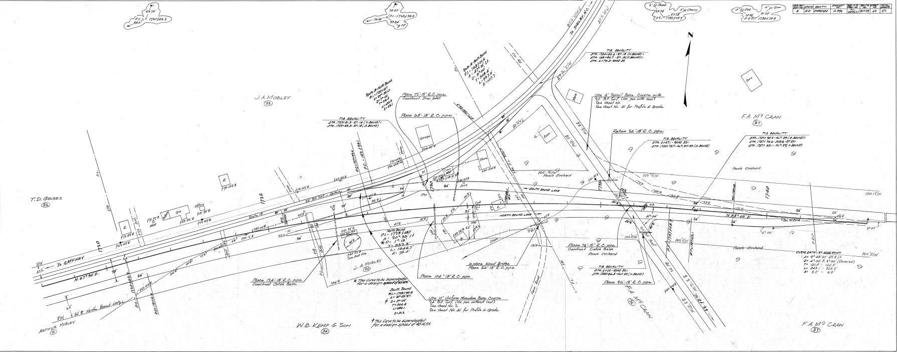
PROJECT HISTORY
Late 1920’s 2-lane US29 was constructed which ran from GA through northern SC into NC.
Late 1950’s US29 was widened to four lanes, interchanges and slip ramps and designated as I-85.
Only limited improvements since designated as I-85
Corridor History

Slide 4
Purpose and Need
What does the project do (Purpose)?
Reduce the traffic congestion of I-85
Correct elements along the mainline, ramps, and interchanges that contribute to congestion
Enhances the safety along the existing facilities
Why is the project necessary (Need)?
Increase the capacity of interstate because sections of the project will over capacity by the 2040 design year
Safety concern with interconnection of interchange ramps and access ramp creating undesirable 2 way movements
Safety concern with driveway access points along ramps creating vehicular conflicts
Safety concern with intersections spacing along crossing routes creating vehicular conflicts

Slide 5
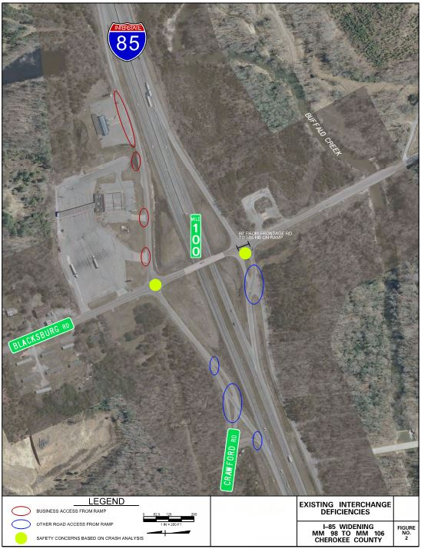
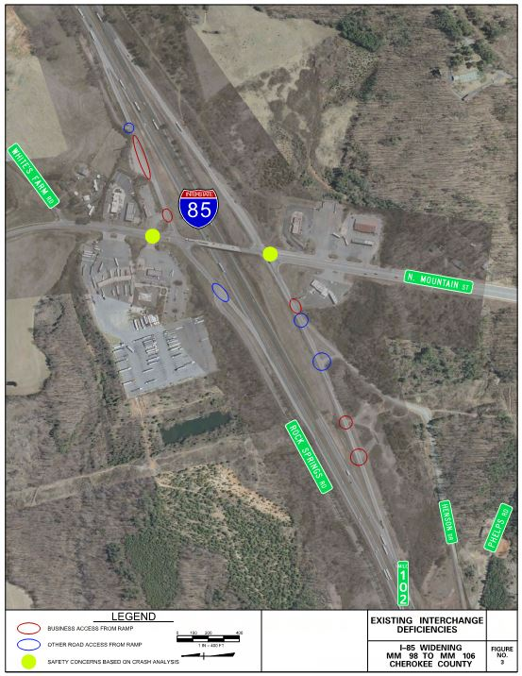
Interchange Improvements
Exit 100
Blacksburg Rd.
Exit 102
N. Mountain St..

Slide 6
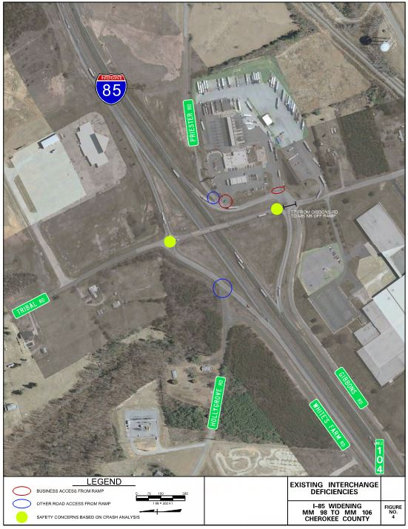
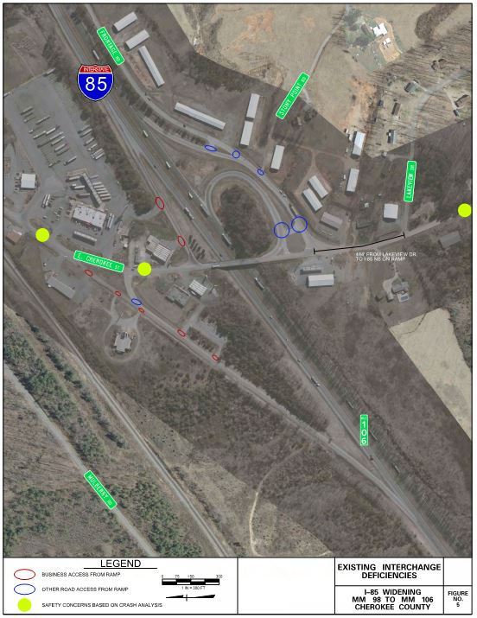
Interchange Improvements
Exit 104
Tribal Rd.
Exit 106
US 29 - E. Cherokee St.

Slide 7
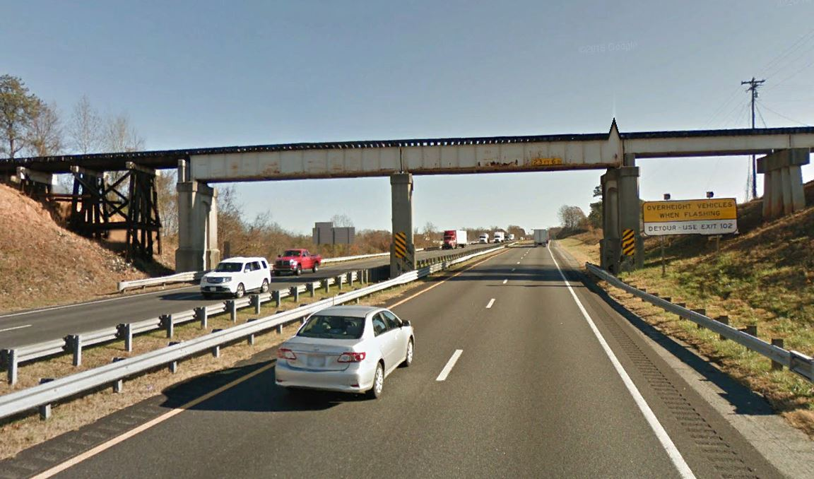
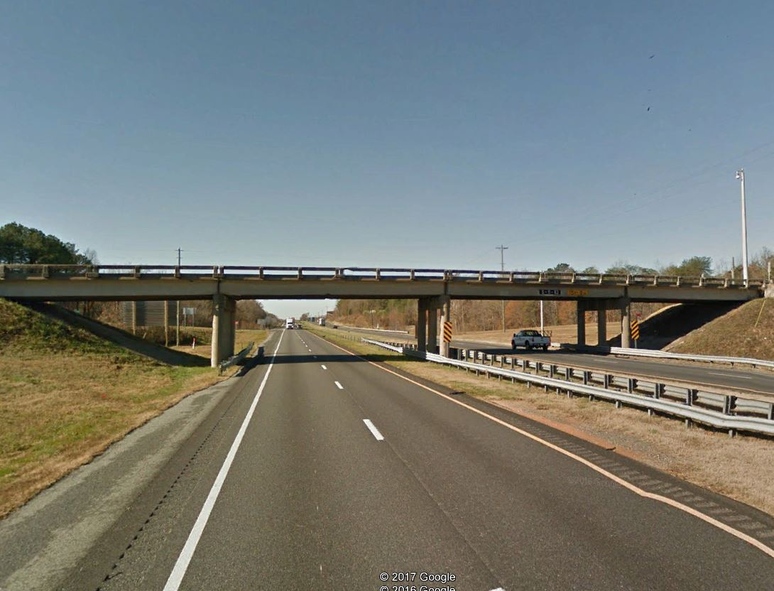
Existing Conditions
Rolling Terrain with grades as steep as 5%
Four lane interstate with grass median for most of the length
The existing right‐of‐way is approximately 100 feet to either side of the center line (200 feet total)
Four interchanges and 9 major bridge structures, including one railroad bridge

Slide 8
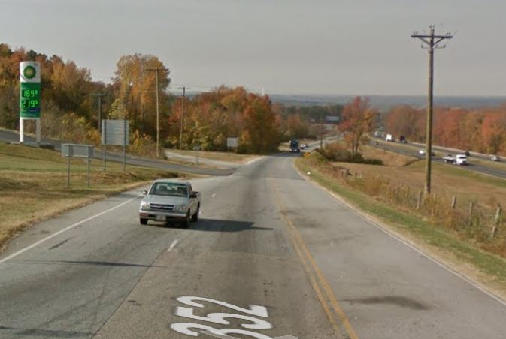
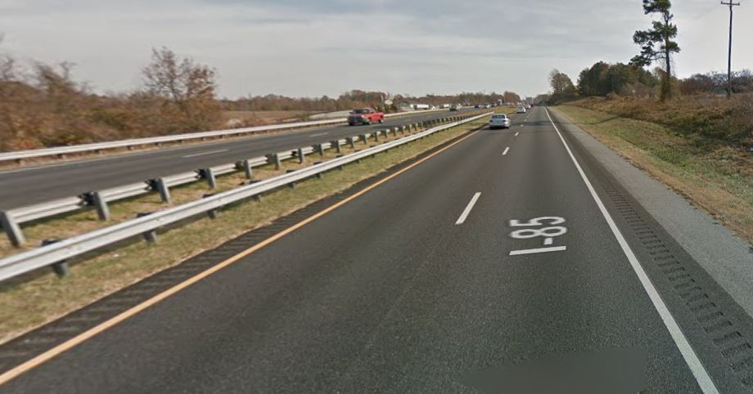
Proposed Project
PROJECT PURPOSE
Widen I-85 from four lanes to six lanes to increase roadway capacity
Interchange Improvements (4 Interchanges)
Safety Improvements
Eliminate Slip Ramps
Improve geometrics

Slide 9
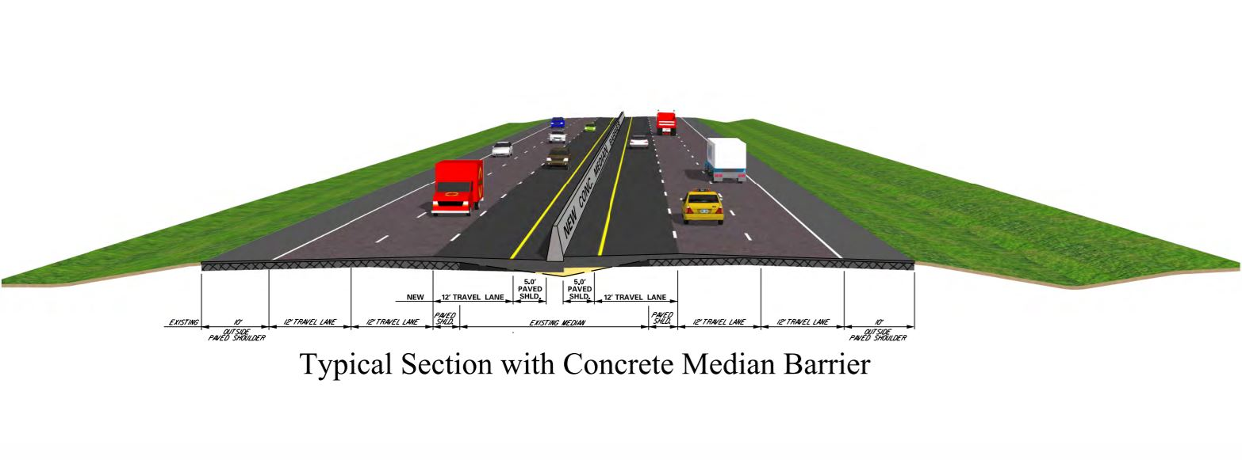
Typical Section

Slide 10
FHWA NEPA PROCESS
Wetlands
Cultural Resources
State & Local Laws
Applicable Federal Laws
Safety
Endangered Species
Air Quality
Parklands
Historic Resources
Civil Rights
Environmental Justice
Community Impacts
Notes:
Talking Points:
The National Environmental Policy Act (NEPA) requires federal agencies to assess the environmental effects of their proposed actions prior to making decisions.
Ensures effects of project on human and natural environment are considered
Ensures environmental information is available to public before action is taken
SCDOT has prepared an Environmental Assessment (EA) in cooperation with FHWA and US Coast Guard.
The NEPA process involves an alternatives analysis where numerous resources are considered, including wetlands, endangered species, and community impacts.

Slide 11
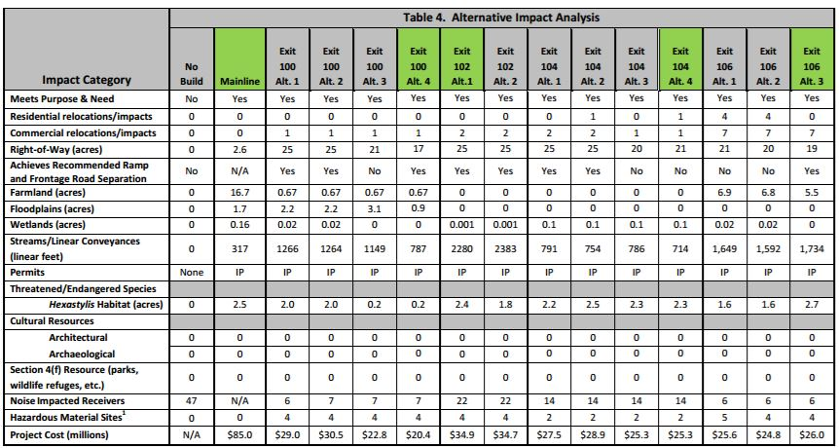
Alternatives Analysis

Slide 12
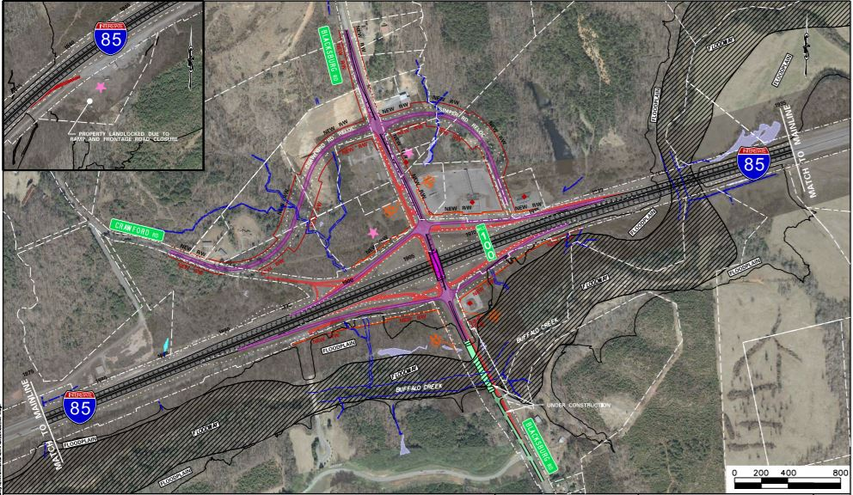
Exit 100 Preferred Alternative

Slide 13
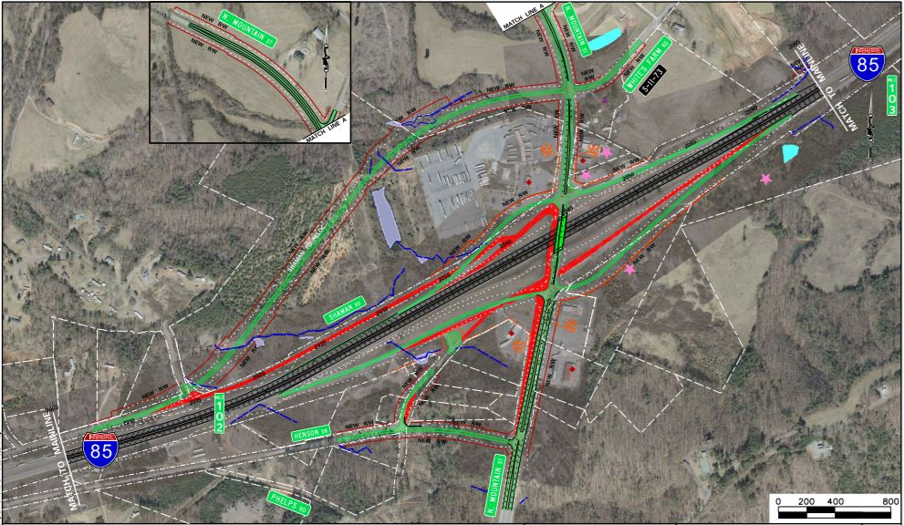
Exit 102 Preferred Alternative

Slide 14
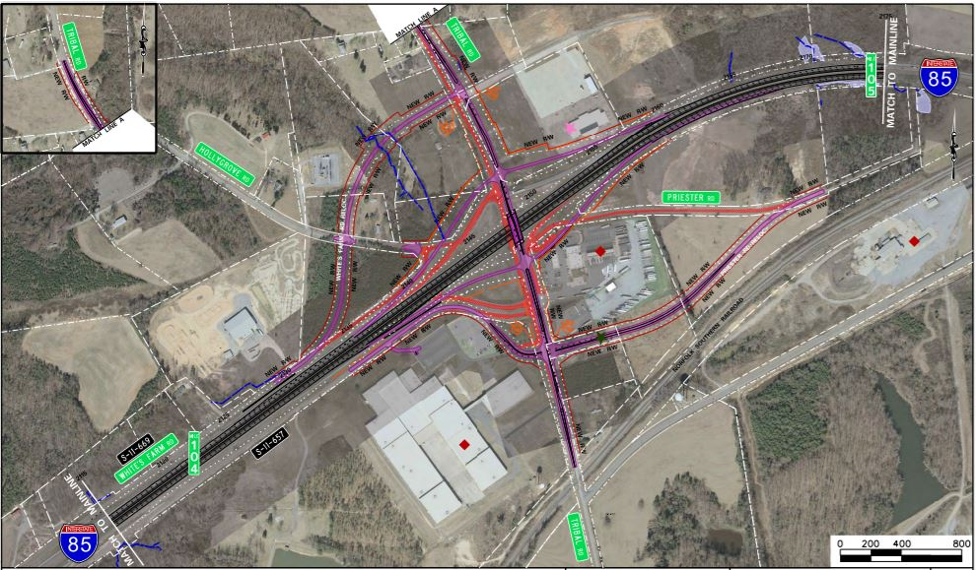
Exit 104 Preferred Alternative

Slide 15
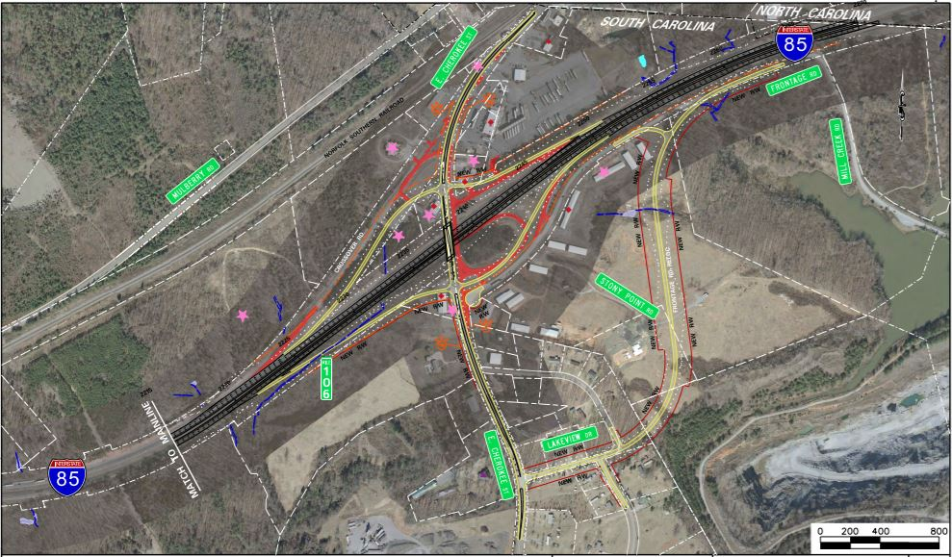
Exit 106 Preferred Alternative

Slide 16
Environmental Considerations
Streams | Right-of-Way | Business Relocations
5,832LF | 82 Acres | 11

Slide 17
REMAINING PROJECT MILESTONES
Public Hearing Comments | March/April 2017
Finding of No Significant Impact (FONSI) | April 2017
Finalize Preliminary Plans | April 2017
Design-Build Contract | February 2018
Begin Right-of-Way Acquisition | Fall 2018
Begin Construction | Winter 2018
Complete Construction | Summer 2022
Estimated Preliminary Construction Cost: $261 millions

Slide 18
Comments
Your input is very important to us!
Please complete comment cards
Drop them in the box as you exit, email, or mail them
Deadline for comments March 29, 2016
South Carolina Department of Transportation
Bradley S. Reynolds, P.E.
955 Park Street
PO Box 191
Columbia, SC 29202-0191
Phone: (803) 737-1440
Email: Reynoldsbs@scdot.org

