Slide 1
S-48 (Columbia Avenue) Corridor Improvement Project
Lexington County Chapin, South Carolina
Public Hearing Presentation
January 17, 2017

Slide 2
What Is the Purpose of the Project?
To improve traffic congestion within the Columbia Avenue Corridor between I-26 and US 76

Slide 3
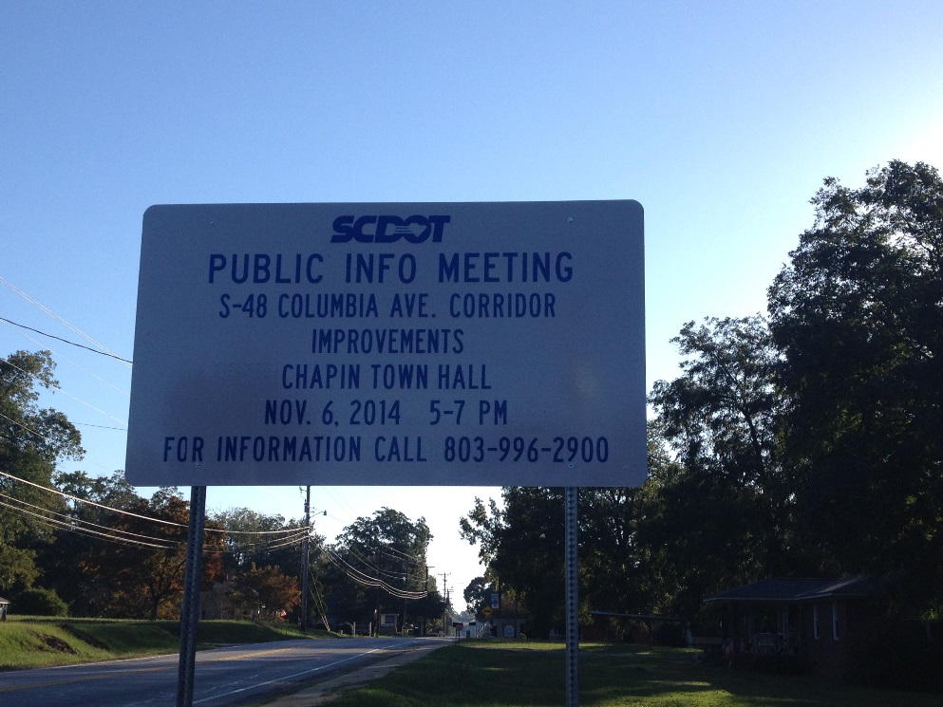
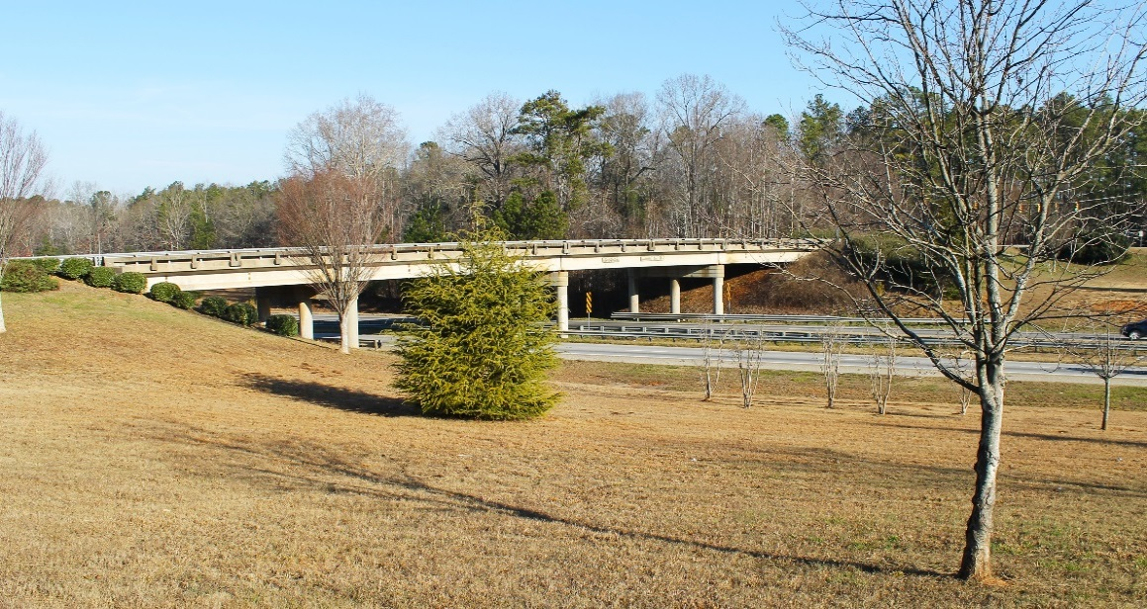
What Is the Purpose of the Public Hearing?
To provide an opportunity to review and discuss the Proposed Preferred Alternative
Continue to gather information from the public or any interested organization
Solicit formal comments from the public

Slide 4
What Alternatives Were Studied?
Total Mainline Alternatives
“No-Build” Alternative
33 “Build” Alternatives
3 Interchange Alternatives
Dual Roundabout
Partial Cloverleaf
Diverging Diamond

Slide 5
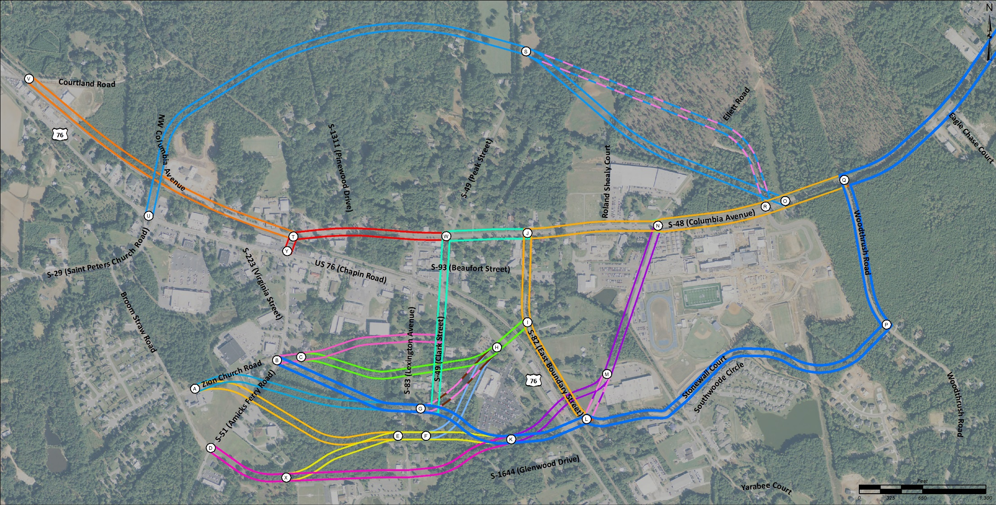
Mainline Build Alternatives

Slide 6
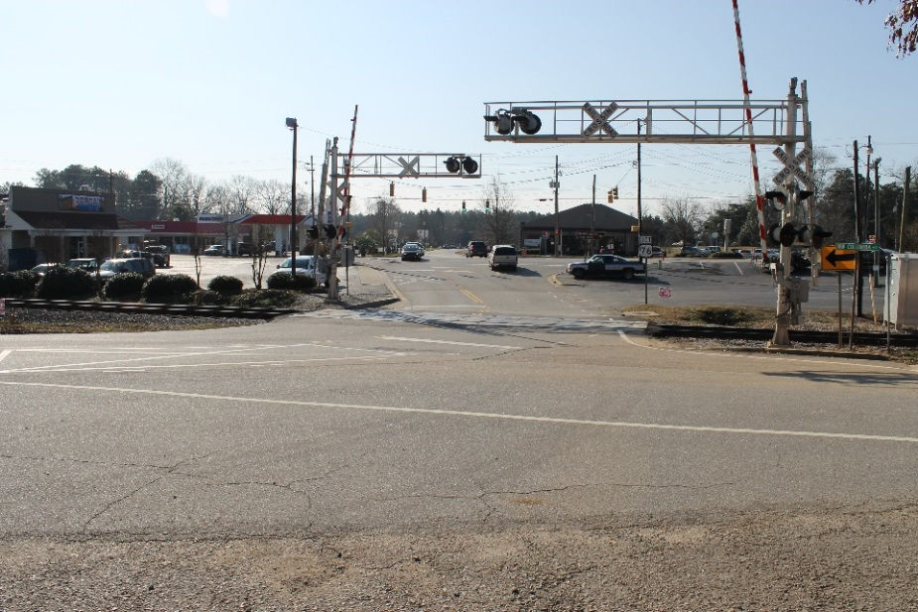
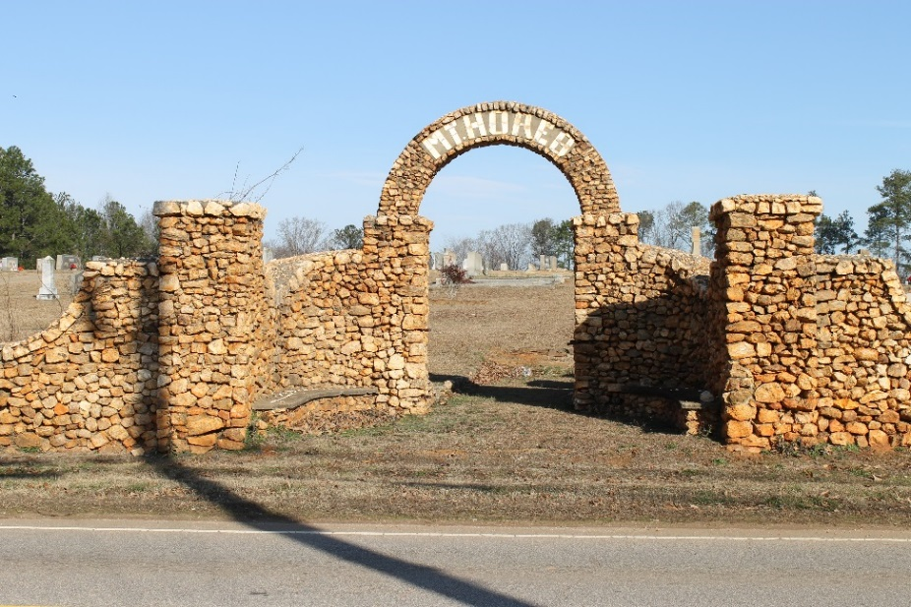
Mainline Build Alternatives Considered But Eliminated
Residential Relocations
Commercial Relocations
Local Church Impacts
Natural Resources
Roadway Safety
Railroad Crossing Safety

Slide 7
Mainline Build Alternatives Considered But Eliminated
21 Mainline Build Alternatives were considered but eliminated from further evaluation
Some of the reasons for elimination:
Roadway and railroad design criteria
Potential impacts to the natural environment
Impacts to the community and character of the Town of Chapin

Slide 8
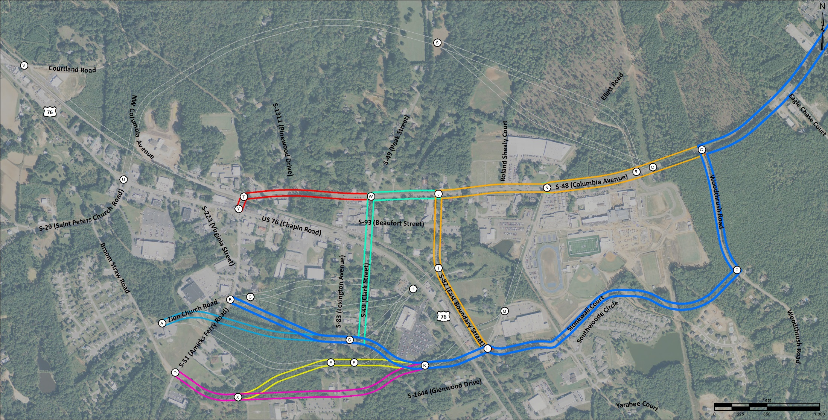
Mainline Build Alternatives Considered for Further Analysis

Slide 9
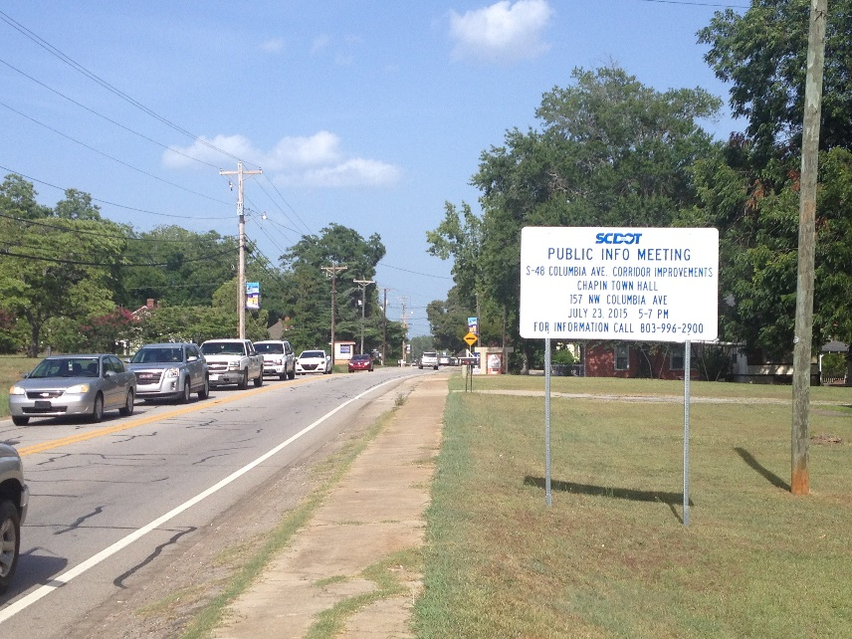
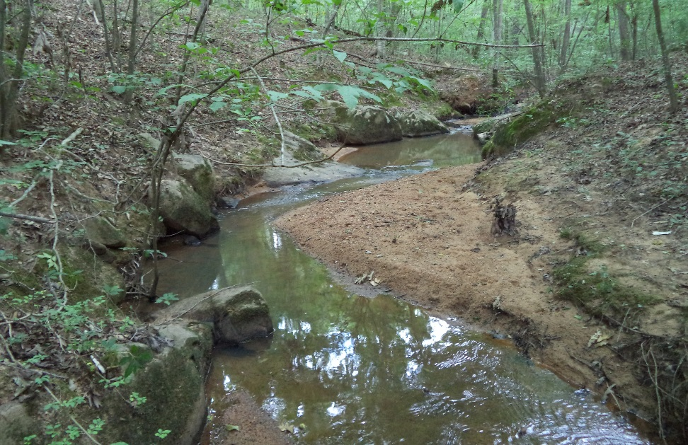
Mainline Build Alternatives
Considered for Further Analysis
Field Verified Jurisdictional Waters
Traffic Operational Analysis
Potential Relocations

Slide 10
10 Mainline Build Alternatives Evaluated Further
7 Additional Mainline Build Alternatives were eliminated
Some of the reasons for elimination:
Future traffic level-of-service along Columbia Avenue did not meet Purpose and Need
Impacts to wetlands and streams
Residential and commercial relocations
Alternative similarities
2 Additional alternatives were added due to public comment for a total of 5 reasonable alternatives

Slide 11
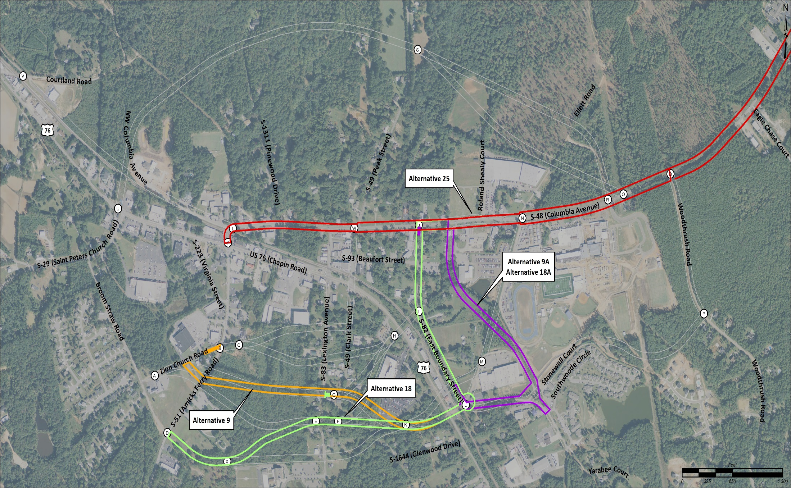
5 Reasonable Mainline Build Alternatives Analysis of Remaining Alternatives

Slide 12
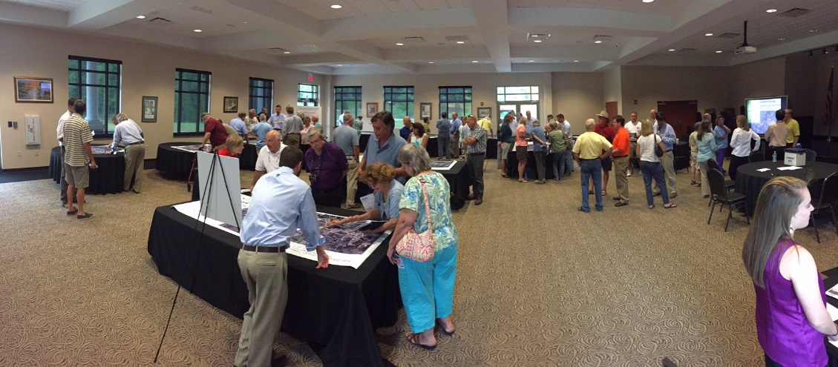
5 Reasonable Mainline Build Alternatives Analysis of Remaining Alternatives
Stakeholders Meetings
Communal Impacts
Potential Relocations
Planned Developments
Introduction of Modified New Alignment Roadway (9A & 18A)

Slide 13
5 Reasonable Mainline Build Alternatives Analysis of Remaining Alternatives
Alternative 9A was selected as the Preferred Mainline Alternative
Some of the reasons were:
Least impact to commercial properties
Fewest number of relocations
Less impact to the natural environment than most build alternatives

Slide 14
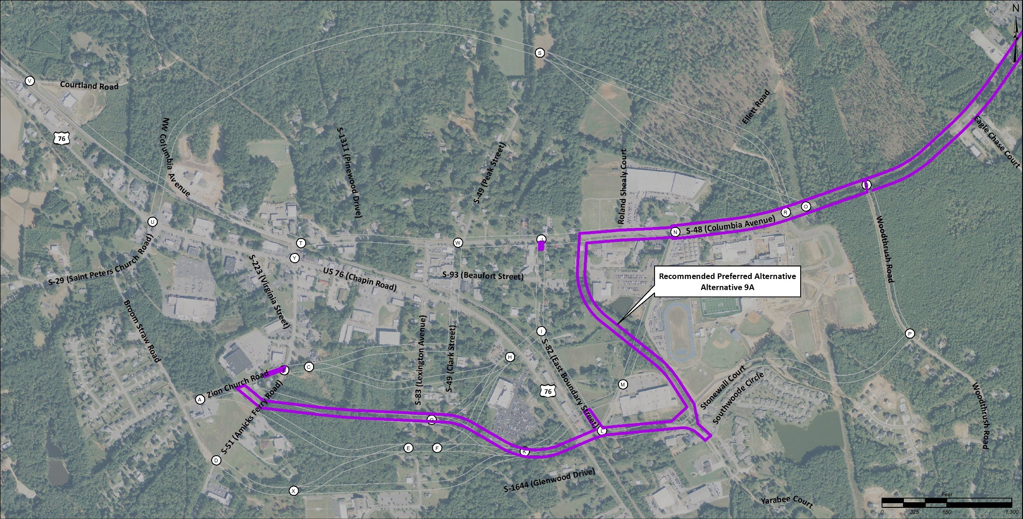
Preferred Mainline Build Alternative

Slide 15
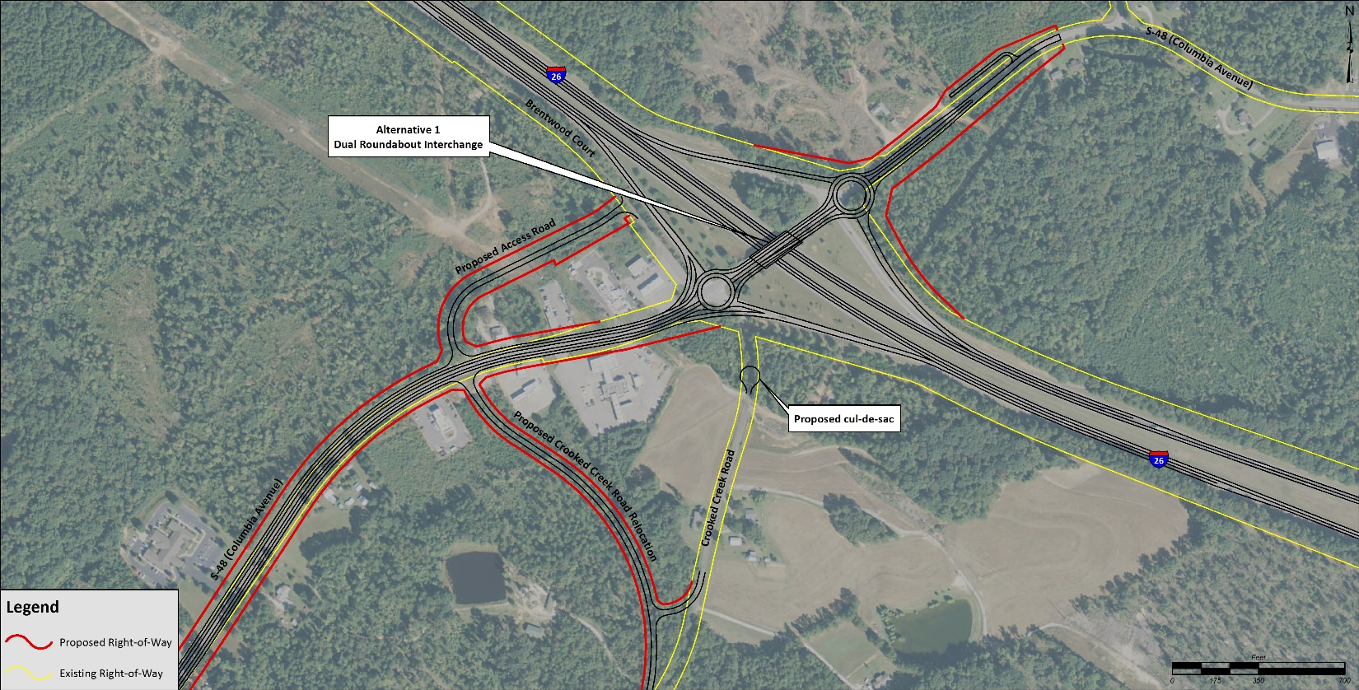
3 Interchange Build Alternatives I-26 & Columbia Avenue
Dual Roundabout

Slide 16
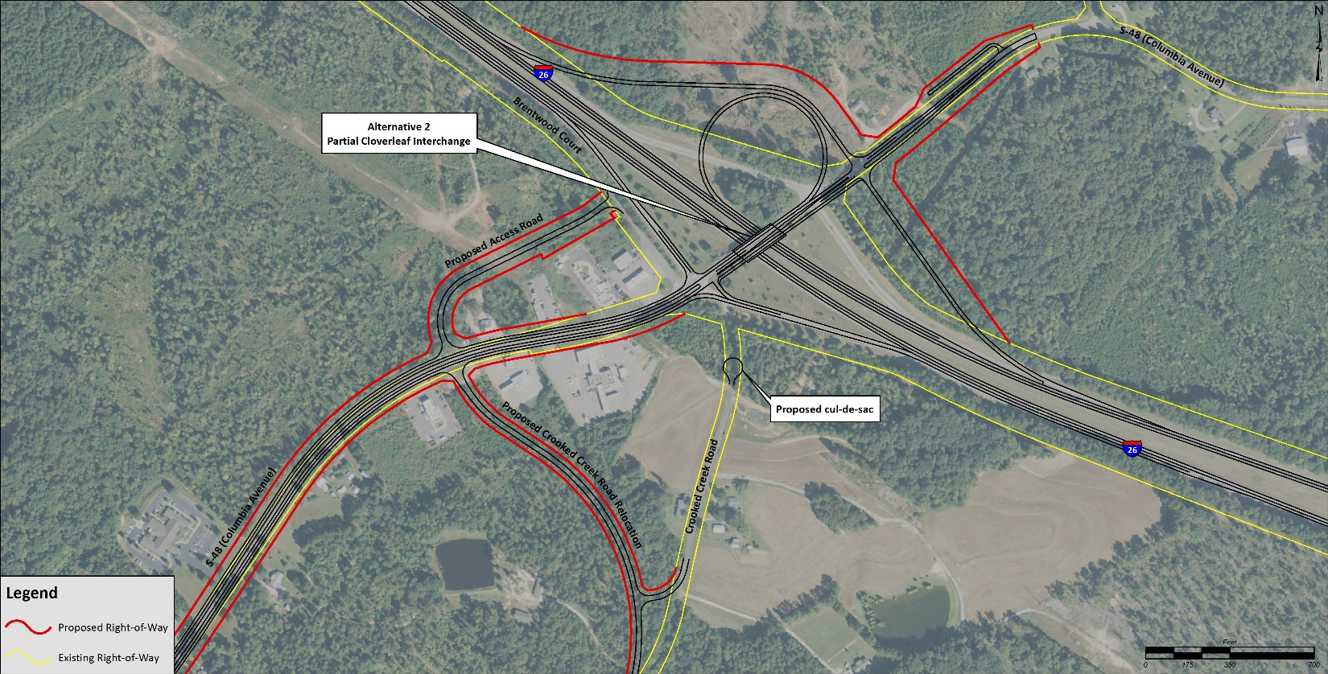
3 Interchange Build Alternatives I-26 & Columbia Avenue
Partial Cloverleaf

Slide 17
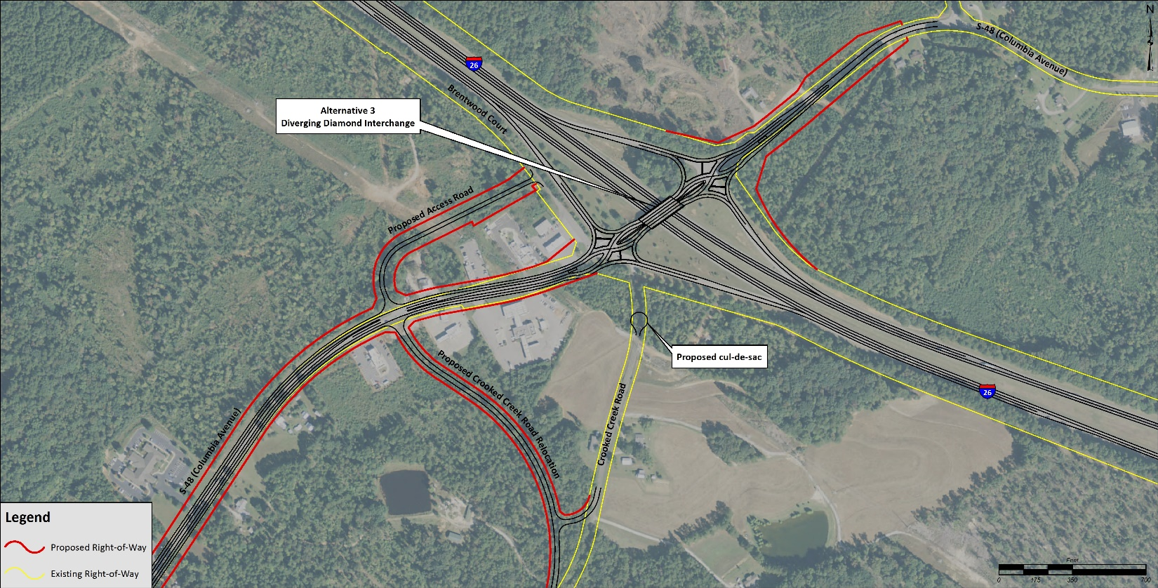
3 Interchange Build Alternatives I-26 & Columbia Avenue
Diverging Diamond

Slide 18
3 Interchange Build Alternatives I-26 & Columbia Avenue
Each alternative was independently evaluated
Property impacts
Environmental impacts
Roadway and traffic data
Cost
The Diverging Diamond was selected as the Preferred Interchange Alternative
Some of the reasons were:
Comparable level-of-service
Less right-of-way
Least environmental impacts

Slide 19
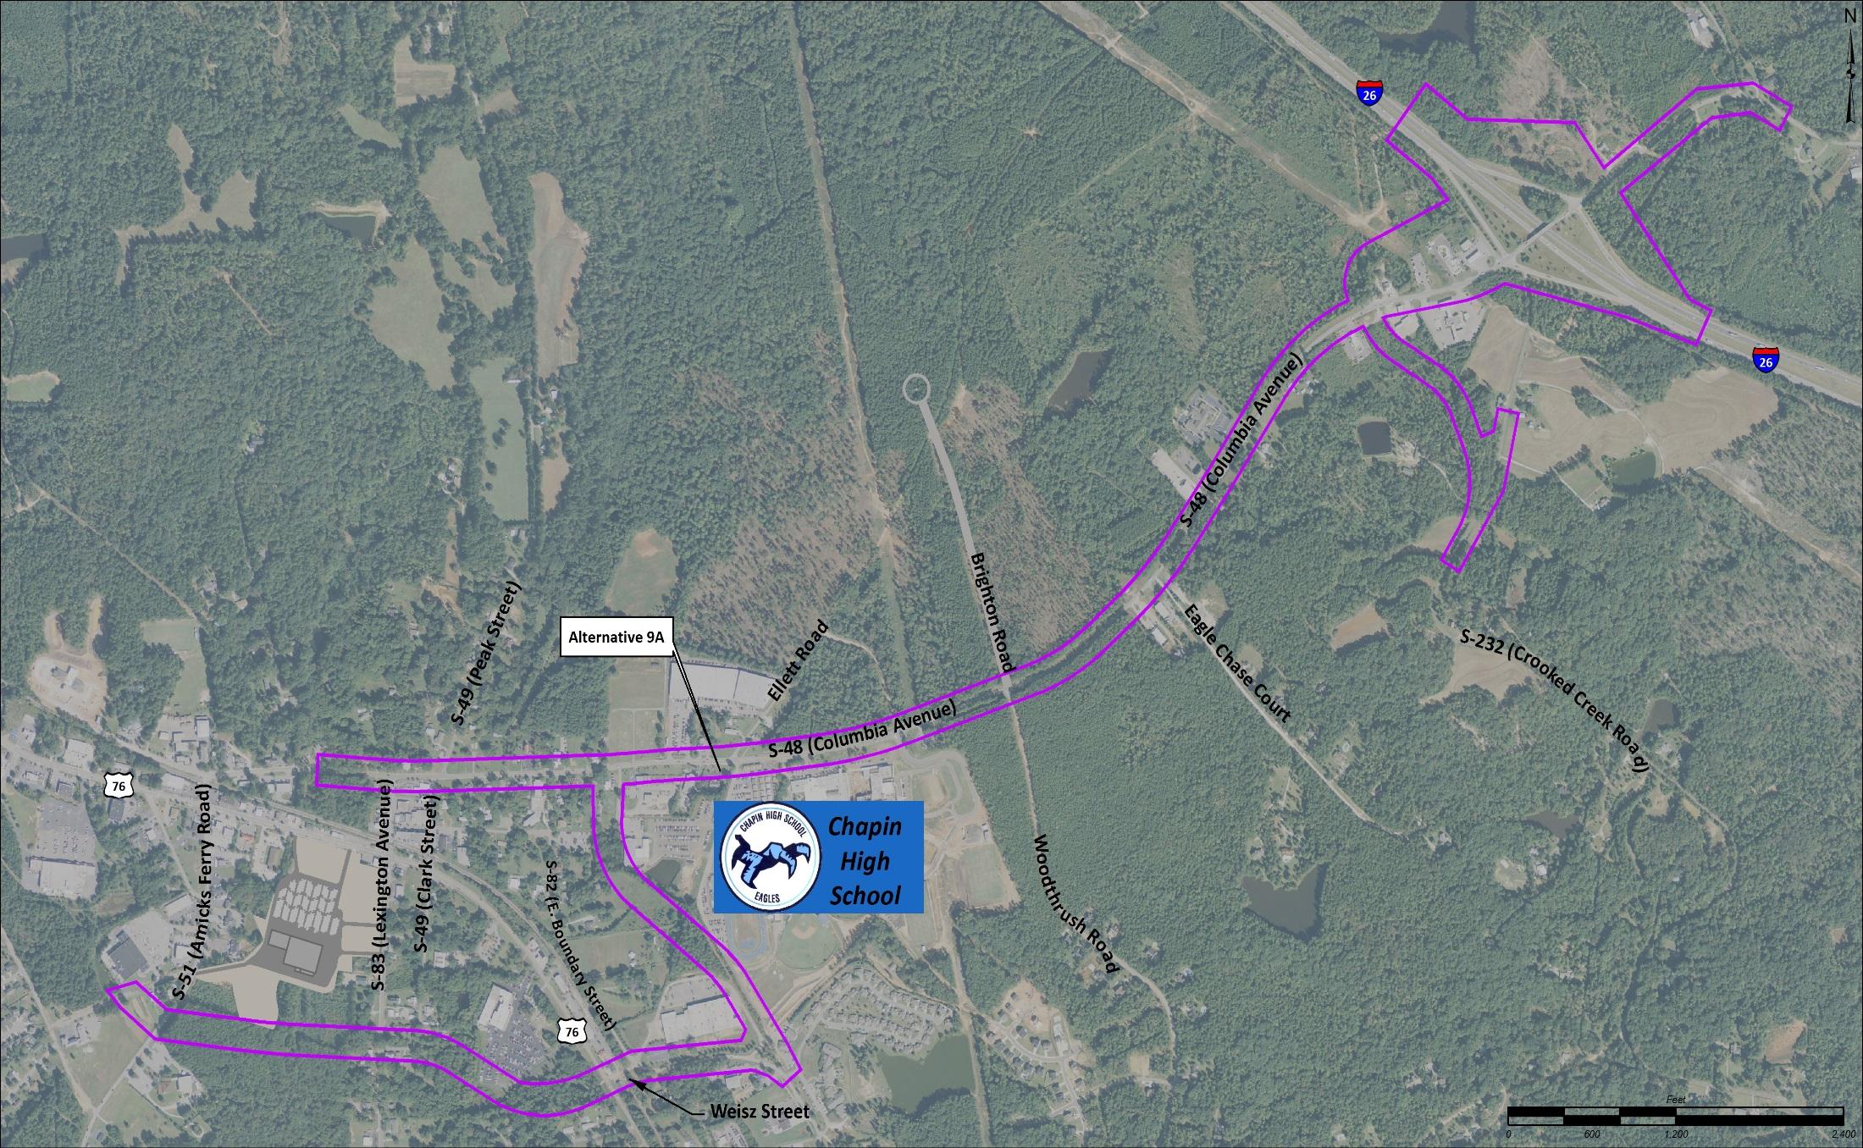
Preferred Alternative

Slide 20
Preferred Alternative 3 Lane Section – Mixed use of urban and rural
RURAL
URBAN
END 3 LANE SECTION
BEGIN 3 LANE SECTION

Slide 21
Preferred Alternative 5 Lane Section – Mixed use of urban and rural
RURAL
URBAN
BEGIN 5 LANE SECTION
BEGIN 5 LANE SECTION

Slide 22
Preferred Alternative New Intersections
NEW INTERSECTION AT COLUMBIA AVE & NEW ROAD 2
NEW INTERSECTION AT LEXINGTON AVE & NEW ROAD 1
NEW INTERSECTION AT AMICKS FERRY RD & NEW ROAD 1
NEW ROUNDABOUT AT EAST BOUNDARY / STONEWALL CT & NEW ROAD 2
NEW INTERSECTION AT US 76 / WEISZ ST & NEW ROAD 1

Slide 23
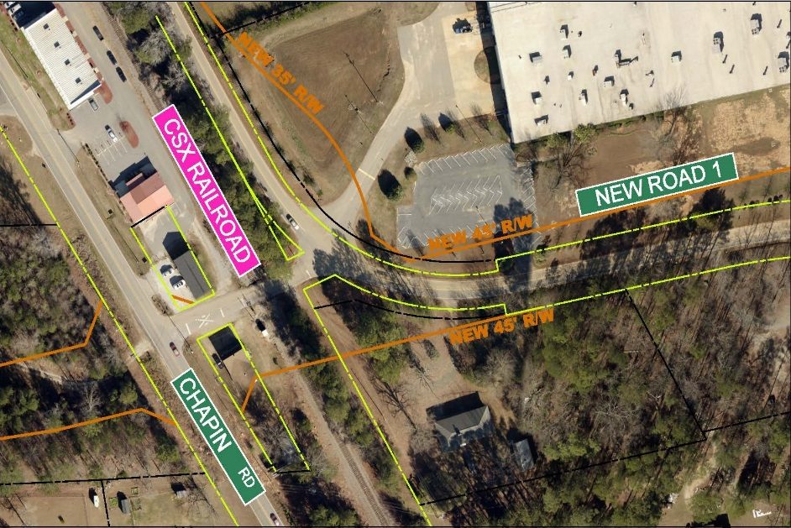
Preferred Alternative Potential Relocations
POTENTIAL RELOCATION -
CAROLINE W. SHEALY LIFE ESTATE

Slide 24
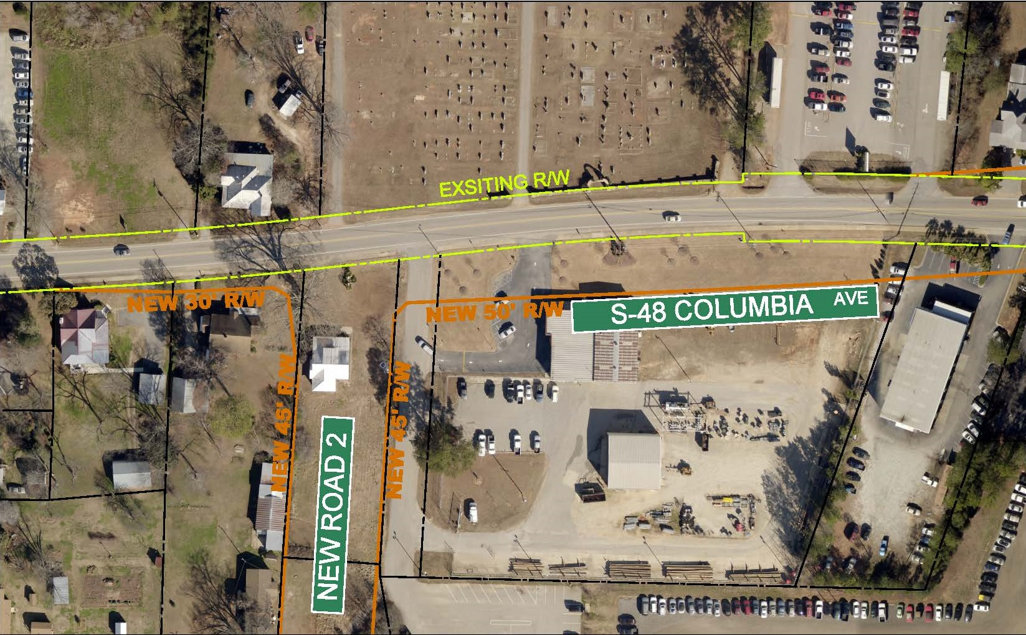
Preferred Alternative Potential Relocations
MT. HOREB CEMETARY WALL WILL NOT BE IMPACTED
POTENTIAL RELOCATION -
DANIEL A. SMITH & JENNETTE SMITH

Slide 25
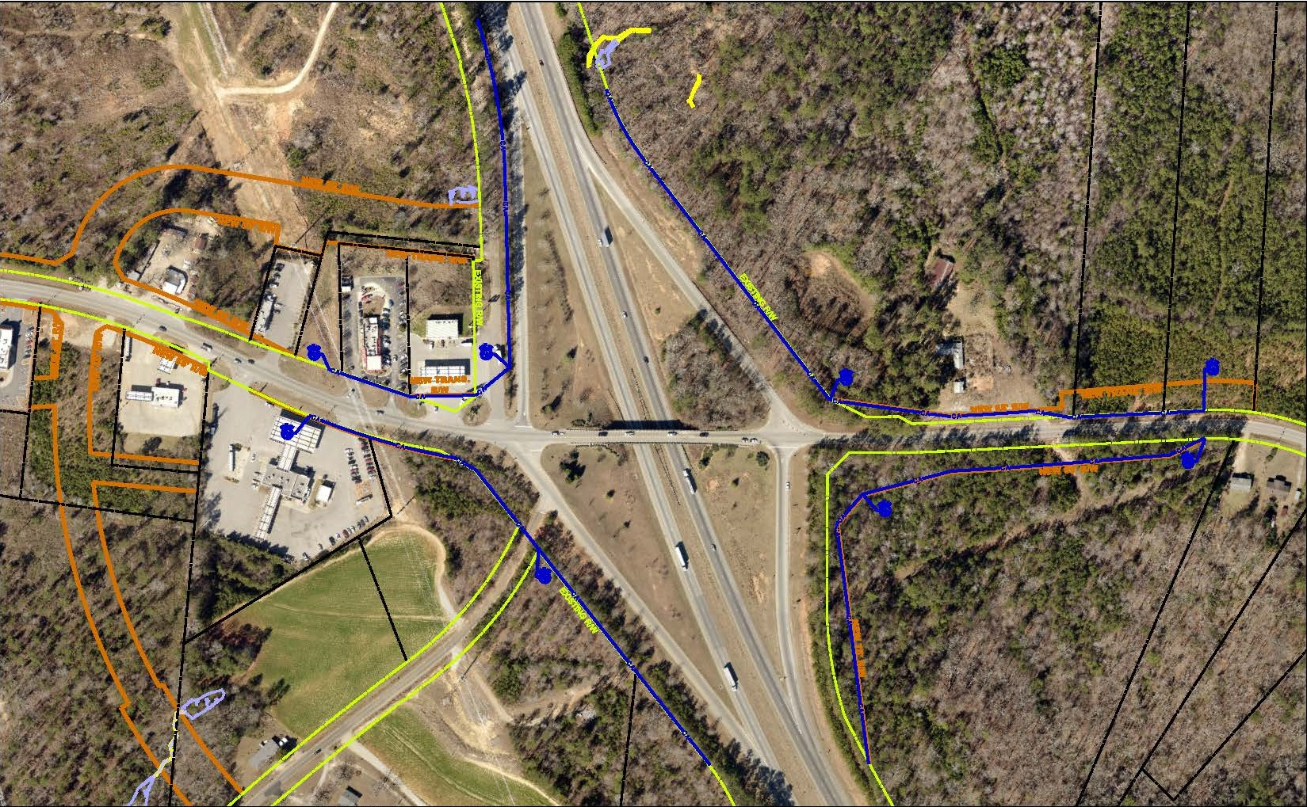
Preferred Alternative Control of Access Around Interchange
CONTROL OF ACCESS (BLUE)
CONTROL OF ACCESS (BLUE)

Slide 26
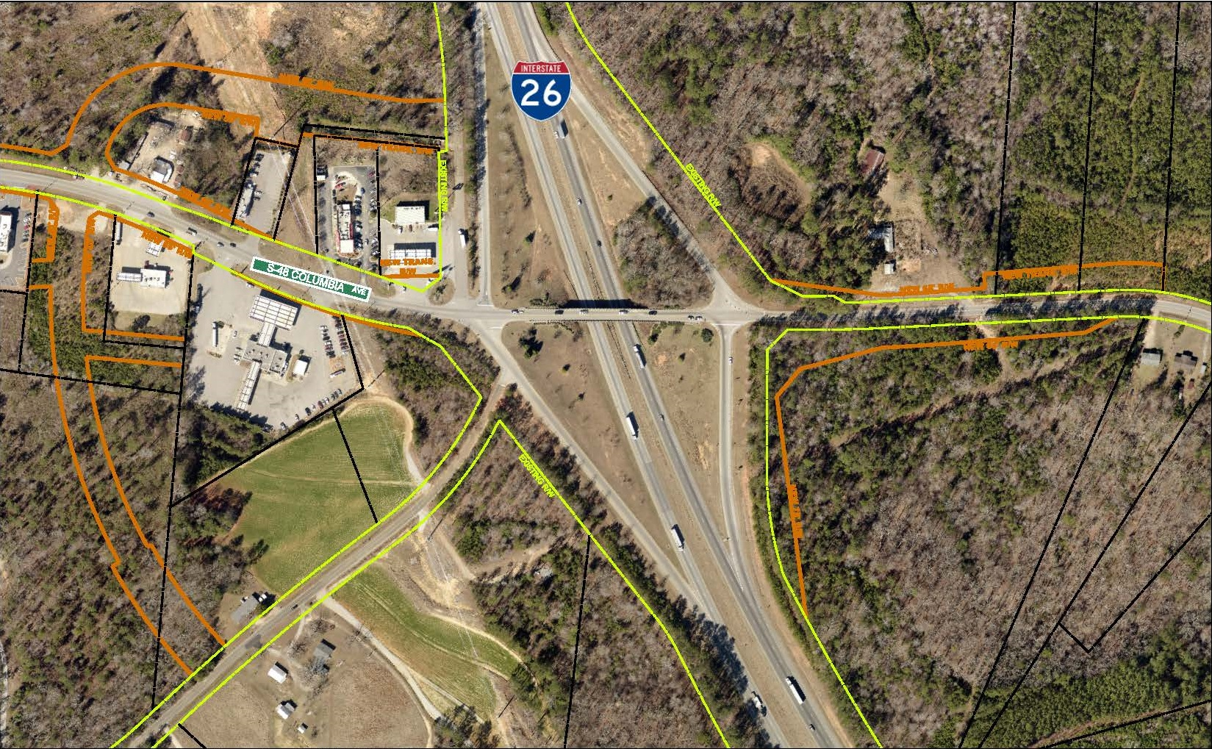
Preferred Alternative Relocated Crooked Creek Road & Frontage Roads
NEW FRONTAGE ROAD
NEW FRONTAGE ROAD
THIS SECTION TO BE REMOVED
NEW CROOKED CREEK ROAD

Slide 27
Preferred Alternative Summary of Probable Effects on the Environment
Total R/W (acres) – 23.0
Potential Relocations – 2
Streams (linear feet) – 383
Wetlands (acres) – 0.14
Floodplains – No Impact
Threatened and Endangered Species – No Impact
Historical / Cultural – No Impact
Section 4(f) / 6(f) Resources – No Impact
Potential Hazardous Material Sites – 3

Slide 28
Phase 1 & Phase 2 Construction Areas
The construction of this project is being separated into two phases
Phase 1 – Interchange area
Phase 2 – Mainline

Slide 29
Phase 1 – Interchange Area Constructed First
Interchange Area

Slide 30
Phase 2 – Mainline Constructed Second
Mainline

Slide 31
Project Schedule Phase 1 & Phase 2
Phase 1 Construction Schedule
Spring 2017 – Begin right of way acquisitions
Winter 2017 – Finalize construction plans
Summer 2018 – Begin construction
Phase 2 Construction Schedule
Summer 2018 – Begin right-of-way acquisitions
Spring 2019 – Finalize construction plans
Summer 2019 – Begin construction

Slide 32
Formal Verbal Comment Period
We will be available after the formal verbal comment period at the display tables to help answer any additional questions.

